Slide 1
Presentation Title | CCNA Curricula Overview
Topic | Comprehensive overview of the CCNA curricula, CCNA Discovery and CCNA Exploration
Content Date | Last updated June 2011
Presentation Tips | Please tailor this presentation to your goals, audience, and time constraints Notes are provided on many slides in this presentation to identify key speaking points and provide additional background As some of the slides are animated, this presentation is best viewed in slideshow mode

Slide 2
CCNA Curricula Overview
June 2011

Slide 3

Contents
Networking Academy Curricula
1
6
Curriculum Prerequisites
CCNA Curricula Overview
2
7
Translation
CCNA Discovery
3
8
Equipment
CCNA Exploration
4
9
Cisco Certifications
Instructor Training
5
Notes:
We’ll begin with a high-level view of our CCNA curricula and the Networking Academy curricula portfolio
Then we’ll talk about the CCNA curricula features and benefits, how the courses are similar and how they differ, and specific details of each curriculum.
Additional topics include required instructor training, pre-requisites, curricula translation strategy, equipment required for the courses and a detailed look at the Cisco certifications that align with the curricula

Slide 4

Networking Academy Curricula

Slide 5

CCNA Curricula Meet Growing Demand
Subtitle: Size 24, Left Aligned
Global studies show a growing demand for IT professionals and a critical shortage of qualified candidates to fill the positions
The Cisco Networking Academy provides the skills needed to meet the demand with a comprehensive learning experience delivered consistently worldwide
Our CCNA curricula prepare students for entry-level career opportunities, continuing education, and globally-recognized Cisco certifications

Slide 6

CCNA Skills for Student Success
Subtitle: Size 24, Left Aligned
CCNA-level skills and knowledge open a world of possibilities for students looking to gain a competitive edge and be successful in a wide range of networking careers today and in the future

Slide 7
The CCNA Learning Experience
Student-Centered Interactive Learning
Online curricula and in-person instruction
Innovative online assessments
Simulation-based learning
21st century skills
Highly interactive e-doing activities, videos, games, and quizzes
Hands-on labs with real equipment
Balance of theory and practical application of skills

Slide 8
ROUTE: Implementing IP Routing
SWITCH: Implementing IP Switched Networks
TSHOOT: Troubleshooting and Maintaining IP Networks
Cisco Networking Academy Curricula Portfolio
Networking for Home and Small Businesses
Working at a Small-to-Medium Business or ISP
Introducing Routing and Switching in the Enterprise
Designing and Supporting Computer Networks
Network Fundamentals
Routing Protocols and Concepts
LAN Switching and Wireless
Accessing the WAN
CCNA
Security
Network Professional
CCNP
IT Essentials: PC Hardware and Software
CCNP
Network Specialist
Security
Network Associate
CCNA Discovery
CCNA Exploration
Network Technician
IT Essentials
IT Technician
Packet Tracer
Student Networking Knowledge and Skills
Notes:
NOTE: this is a build slide
Our current portfolio consists of 13 courses
IT Essentials: PC Hardware and Software —provides an overview of how the internal components of a computer work The course covers laptops and portable devices, assembling/disassembling PC components, wireless connectivity, security, safety and environmental issues associated with installing, configuring and troubleshooting and a PC.
CCNA Discovery (4 courses) —provides an introduction to networking. It teaches networking based on application and helps students develop foundational routing, switching, and WAN knowledge and experience, which can be applied toward entry-level careers in networking for small and medium-sized businesses.
CCNA Exploration (4 courses) —provides an introduction to networking. It teaches networking based on technology. It covers routing, switching, and WAN protocols and theory at deeper levels to help students succeed in networking-related degree programs and a range of professions.
CCNA Security –helps students develop a comprehensive understanding of network security concepts, and gain the knowledge and skills needed to earn the Cisco CCNA Security certification and become entry-level security specialists.
CCNP (3 courses) —the CCNP curriculum focuses on the advanced routing, secure wide area access, multilayer switching, and networking management skills required to implement and maintain converged enterprise networks.
Cisco Packet Tracer — Provides a realistic simulation and visualization learning environment that supplements classroom equipment. Cisco Packet Tracer is a foundational teaching tool for CCNA Discovery and CCNA Exploration, withPacket Tracer activities embedded in the course content. Both curricula include embedded e-doing, which applies the principle that people learn best by interacting with computer-based activities. Interactive learning promotes the exploration of networking concepts and experimentation with tools such as Packet Tracer and Flash-based activities to help students develop a greater understanding of networking technologies. Packet Tracer activities are also available for IT Essentials and CCNA Security.
8

Slide 9
Cisco Networking Academy Curricula Portfolio
Alignment to Certifications
CompTIA A+
CCNA CCENT
CCNA
CCNA Security
CCNP
IT Essentials
CCNA Discovery
CCNA Exploration
Security
CCNP
Student Networking Knowledge and Skills
Notes:
All of our curricula help prepare students for industry recognized certifications:
IT Essentials: PC Hardware and Software — CompTIA A+ certification
CCNA Discovery (first 2 courses) — CCENT certification
CCNA Discovery (4 courses) — CCNA certification
CCNA Exploration (4 courses) — CCNA certification
CCNA Security - CCNA Security certification
CCNP (4 courses) — CCNP certification
9

Slide 10

CCNA Curricula Overview

Slide 11
Why Two CCNA Curricula?
CCNA Discovery and CCNA Exploration are:
Designed to meet the diverse needs of different types of students
Use different methodologies to teach the same core concepts
Target different student segments based on academic experience, skills, and goals
Accommodates varied educational approaches and learning styles to help all students succeed

Slide 12

Core Skills for Certification and Careers
Basics of Routing and Switching
CCNA Discovery
CCNA Exploration
Networking based on application
Spiral approach, concepts build in context of network environments
General theory and career exploration
Networking based on technology
Top-down approach, deep into protocols and theory
Integrates with engineering concepts
Core Skills for CCNA Certification
Skills for Entry-level Careers Such as:
Help desk technician
Network technician
Network installer
Network administrator
Network engineer
Key Factors in Obtaining Jobs: Education, Experience, and Certification
Notes:
12
NOTE: This is an animated slide that builds after each display. Please step through this slide slowly and discuss each addition after the visual effect displays!
Initial Display:
You may be wondering how these two curricula with different features and benefits can both lead to the same certification?
Display 2:
The CCNA Discovery and CCNA Exploration curricula both cover the core skills required to prepare for CCNA certification, with more than 200 hours of class material.
In addition, both CCNA curricula offer a rich environment filled with extensive interactivity and networking skills and knowledge that extend beyond the minimum requirements for the CCNA certification.
Display 3:
CCNA Discovery provides foundational networking knowledge and experience, as well as career exploration and soft-skills development. This curriculum presents basic networking education to equip students with knowledge and skills that can be applied toward entry-level careers in IT and networking
Display 4:
CCNA Exploration presents a comprehensive overview of networking from fundamentals to advanced applications and services. This curriculum prepares students for a range of networking professions, provides students with the skills needed to succeed in networking-related degree programs, and allows for easier integration with related programs of study
Display 5:
While the CCNA curricula help prepare students for entry-level jobs, an individual’s education, experience and industry certifications are also key ingredients in obtaining career opportunities.

Slide 13
Key Features of Both Curricula
Emphasize critical thinking, problem solving, collaboration, and the practical application of skills
Offer embedded, highly interactive e-doing activities that stimulate learning and improve knowledge retention
Include hands-on labs, simulation-based learning activities, and innovative online assessments
Help prepare students for entry-level career opportunities, continuing education, and globally-recognized Cisco certifications
Provide learning pathways from secondary to postsecondary institutions

Slide 14





Skills for the 21st Century
The Learner at the Center
Problem Solving and Decision Making:
Creative and Critical Thinking:
Hands-on labs and the Packet Tracer simulation-based learning environment for configuring and troubleshooting networks
Challenging assessments, including chapter tests and skills based exams
Problem-based interactive online activities and complex labs
Packet Tracer allows students to explore concepts, conduct experiments, and test understanding
Case studies present problems, projects and career activities students will encounter on the job
Students can create their own activities, games, or virtual networks of any size with Packet Tracer
Intellectual Curiosity and the Ability to Find, Select, Structure, and Evaluate Information:
Collaboration, Communication, and Negotiation:
Group lab assignments reinforce teamwork and communication
Multiuser Packet Tracer activities require collaboration and coordination
Realistic business scenarios provide practice in communicating and negotiating with customers
Challenge labs encourage exploration and research
Real-world case studies give students the opportunity to structure projects that expand their knowledge
Labs require students to organize information, consider alternatives and use higher-order thinking skills
Notes:
14
14
Our students need skills to be successful & compete in the 21st century… (prediction) 8 jobs in their careers…
CCNA Discovery and CCNA Exploration integrate real-world skills into the technical curricula to create a learning experience for success in future educational, entrepreneurial, and occupational endeavors.
Students not only learn the fundamentals of designing, building, and operating networks, they also learn about problem solving, critical thinking, collaboration, teamwork, negotiation, and entrepreneurship - skills they can apply in their future education and in the 21st century global workplace.
The curricula facilitate the learner at the center while catering for differing learning styles ….authentic mix of theory, interactive flash-based activities, real hands-on labs (every lab is a mini project-based assignment). Makes it possible for understanding to occur
Games: binary game; alien space ship
Interactive media with immediate feedback
PT allows unlimited access to virtual devices
Instructor enabled to take on role of facilitator….

Slide 15
Innovative Assessments
Assessment Framework
Formative Assessment, Measure Understanding
Formative Assessment, Performance-Based
Student Initiated
Knowledge Flow
Quizzes, Testlets, Drag ‘n Drop
Packet Tracer, Labs, Simulations
Formative Assessment, Measure Understanding
Formative Assessment, Performance-Based
Summative Assessment
Instructor Initiated
Knowledge Flow
Hands-on Skills Based Assessments, Final Exams, Midterms, Packet Tracer
Chapter Exams, Practice Finals
Flash Rich Media, Packet Tracer, Simulations, Packet Tracer Skills Assessments
Cert Practice Exams
Notes:
15
We created this assessment framework to ensure a common understanding of our terminology and assessment purpose; and provide a pedagogical view of the assessment suite
The framework divides assessment into two categories, student initiated and instructor initiated. Student initiated assessment is an assessment that a student can take, receives feedback on, and typically is not scored by the instructor.
The framework highlights the types of assessments for students & instructors, with knowledge flow from formative assessments (assessments that provide student practice and support mastering critical concepts) to summative assessments that provide an accurate reflection of students’ content knowledge.
Formative assessments are designed to give detailed feedback about the particular strengths and weaknesses of a student while the student is learning. Summative assessments are designed to summarize the knowledge or skill sets of a student. Summative assessments usually cover a broader range of information than formative assessments and provide less detailed feedback.

Slide 16
Assessments in CCNA Curricula
Student-initiated interactive quizzes are embedded in all courses
Online chapter, practice final, and final exams are scored immediately and provide personalized feedback
Cisco certification practice exams help students prepare with rich media tasks similar to those found on the actual certification exams
Students must successfully complete skills-based assessments that test their skills on real equipment
Packet Tracer Practice Skills Based Assessments support student success by helping to prepare students for the critical hands-on skills exam
Notes:
State-of-the-art formative and summative assessment techniques and technologies are integrated into the CCNA Discovery and CCNA Exploration curricula. An advanced online delivery system supports sophisticated assessments and complex scoring approaches. Immediate, rich feedback appropriate to the exam type supports instructor and student evaluation of knowledge and skills acquired. Assessments can be as simple as a multiple choice question or as complex as troubleshooting a simulated network.

Slide 17


CCNA Curricula Selection Considerations
Student academic experience
Student abilities
Student learning styles
Student goals
Instructional approach
Teaching style
Notes:
There are several factors to consider in determining which CCNA curriculum best suits your needs.
Options to consider:
Many academies offer both the CCNA Discovery and CCNA Exploration curricula to provide the best fit for different types of students with different goals. For example, a postsecondary institution may offer either CCNA Discovery or CCNA Exploration for students in IT or engineering degree programs, and CCNA Discovery for students in other degree programs or broader courses of study.
If an academy wants to offer both curricula for different types of students but cannot due to resource restrictions, we suggest a hybrid offering of the first two courses from the CCNA Discovery curricula, followed by courses 2-4 from the CCNA Exploration curricula.
CCNA Discovery is a good choice to provide technical and information literacy to every student, regardless of their education level, course of study or educational or career goals, ensuring that all students are viable candidates in the global workplace.

Slide 18


Different Methodologies
CCNA Discovery
CCNA Exploration
Teaches networking based on application, in context of network environments
From small office and home office (SOHO) networking to more complex enterprise and theoretical networking models later in the curriculum
Teaches networking based on technology, using a top-down, theoretical approach
From network applications to the network protocols and services provided to those applications by the lower layers of the network
Notes:
Both of the new CCNA curricula prepare students for entry-level jobs, certification and professional degrees using different approaches.

Slide 19
Curricula Overview
CCNA Discovery
CCNA Exploration
General networking theory
Hands-on, career-oriented approach to learning networking
Emphasizes practical experience and career opportunities and encourages additional IT education
Designed to make IT relevant and applicable to a student’s daily life
Prepares students for entry-level IT careers as early as the first two courses
Covers protocols and theory in depth
Uses language that allows for integration with engineering concepts
Provides skills needed to succeed in networking-related degree programs
Prepares students for entry-level IT careers after the completion of the four-course curriculum

Slide 20
Curricula Overview
CCNA Discovery
CCNA Exploration
Many interactive activities break up reading of the content and reinforce understanding of networking concepts
Explains networking concepts using simple, straightforward language that works well for learners at all levels, including introductory level and less experienced learners
Fewer interactive activities and more content promoting a deeper, theoretical understanding of networking concepts
The curriculum discusses networking concepts in greater depth, providing more details and theory for experienced learners with advanced problem-solving and analytical skills

Slide 21
Hands-On Labs
CCNA Discovery
CCNA Exploration
Starts with structured, easy-to-follow labs with detailed instructions to help students develop and practice their understanding
Progresses to more challenging tasks that build critical thinking and problem solving skills
A large number of labs included to encourage additional hands-on practice
Starts with structured, easy-to-follow labs
Progresses to more advanced labs that build critical thinking and problem solving skills and encourage exploration and research
Students may need to rely on additional resources to derive final solutions for the more complex labs

Slide 22
Learning Environment
CCNA Discovery
CCNA Exploration
Can be delivered as an independent curriculum or integrated into a broader course of study, such as technology or continuing education programs
Appropriate for students at many education levels and types of institutions including high schools, secondary schools, universities, colleges, career and technical schools, community organizations, and other non-traditional learning environments
Can be delivered as an independent curriculum or integrated into a broader course of study, such as degree programs in IT, engineering, math, or science or continuing education programs
While primarily designed for postsecondary institutions, this curriculum is appropriate for students at many education levels if they have the required skills, and if the instructional approach complements their learning style and educational goals

Slide 23
Student Abilities and Learning Styles
CCNA Discovery
CCNA Exploration
Designed for students with basic PC skills and foundational math and problem solving skills
Students are not expected to have knowledge of binary math and algorithms detailed explanations and tools such as a binary calculator are provided
Offers an engaging learning experience for more visual and kinetic learners
Designed for students with advanced problem solving and analytical skills, such as students pursuing degrees in engineering, information technology, math, or science
Students are expected to know binary math and understand the concept of algorithms
Offers a comprehensive and theoretical learning experience for analytical students
Notes:
CCNA Discovery and CCNA Exploration use a segmented approach to instruction for students with different goals, skills, interests and educational backgrounds.
All courses are designed to be delivered in a learning environment that combines face-to-face instruction with independent learning. This promotes student-centered, interactive learning and optimizes the learning environment for different types of learners – students who learn best with direct classroom support and students who are more self-directed.
Both curricula teach the same applied skills but present the information in different ways to appeal to different student segments, in order to build on their strengths and help all students succeed.

Slide 24
Student Goals
CCNA Discovery
CCNA Exploration
Offers a pathway for students who plan to pursue additional IT education or begin their careers
Prepares students for entry-level IT careers as early as the first two courses
The first two courses help students prepare for the CCENT certification exam
The entire four course series helps students prepare for the CCNA certification exam
Helps students advance their technical knowledge and skills for academic success and career readiness
Prepares students for entry-level IT careers after the completion of the four-course curriculum
The entire four course series helps students prepare for the CCNA certification exam

Slide 25
Paths to CCNA Certification
CCNA Discovery
CCNA Exploration
CCNA Discovery
Networking for Home and Small Businesses
Networking Fundamentals
Networking for Home and Small Businesses
Working at a Small-to-Medium Business or ISP
Routing Protocols and Concepts
Working at a Small-to-Medium Business or ISP
CCENT Certification (optional)
LAN Switching and Wireless
CCENT Certification (optional)
Introducing Routing and Switching in the Enterprise
Accessing the WAN
CCNA Exploration
Designing and Supporting Computer Networks
Routing Protocols
and Concepts
LAN Switching and Wireless
Accessing the WAN
CCNA Certification
Notes:
There are three pathways to entry-level careers and CCNA certification
Students learn the basics of routing, switching, and advanced technologies to help them prepare for Cisco CCENT and CCNA certifications
CCENT and CCNA certifications are highly valued in the global networking industry and provide validation of the skills and knowledge required for entry-level networking careers.
The first two courses of CCNA Discovery help students prepare for the CCENT certification exam.
The entire four course series of CCNA Discovery or CCNA Exploration helps students prepare for the CCNA certification exam.
Students can also follow a hybrid path consisting of the first two courses from the CCNA Discovery curricula, followed by courses 2-4 from the CCNA Exploration curricula.

Slide 26
CCNA Curricula Articulation
Course Credit
Generally developed at the institutional level based on existing programs and pathways
CCNA Discovery
CCNA Exploration
Networking for Home and Small Businesses
Working for a Small-to-Medium Business or ISP
Equivalent Knowledge
Network Fundamentals
Equivalent Credit
Students who complete all four CCNA Discovery or CCNA Exploration courses will be prepared to begin the CCNP curriculum
An institution may choose to grant CCNA Exploration credit for students who complete the CCNA Discovery curriculum
Notes:
Course credits are typically provided by institutions based on the programs students have taken to apply to other courses. Here we are offering suggested articulation options for students who have completed the CCNA courses.

Slide 27

Tools and Resources

Slide 28
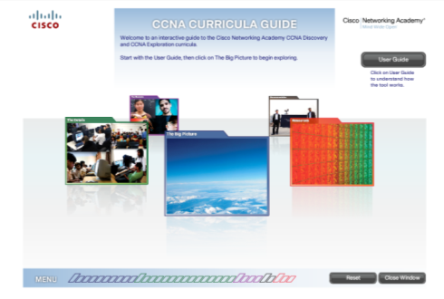
CCNA Curricula Guide
An interactive guide to our CCNA Curricula
See http://www.cisco.com/web/learning/netacad/course_catalog/newCCNA.html
Presents similarities and differences between CCNA Discovery and CCNA Exploration
Make selections to generate a curriculum recommendation best suited for your needs
Features real examples of activities, labs, and games from the actual curricula - experience the curricula instead of just reading about it
Notes:
We’ve created an interactive guide to help you understand the similarities and differences between CCNA Discovery and CCNA Exploration.
The guide provides a good overview of our CCNA curricula and will help you understand the similarities and differences between CCNA Discovery and CCNA Exploration. As you navigate the tool, you can make selections to generate a curriculum recommendation that best fits your needs.
The CCNA Curricula Guide includes examples of interactive activities, labs, videos, and games from the actual curricula to help you fully experience the courses instead of just reading about them. It also provides links to additional resources you can explore for more information.
This guide was primarily designed for education decision makers, but also provides a good overview for all administrators, instructors, counselors, parents, and prospective students. We encourage you to launch and explore the guide and hope you’ll provide feedback by clicking the survey link on the recommendation page.

Slide 29
Resources on Academy Connection
Datasheets
Scope and sequence documents
Detailed equipment list
Product demos
FAQs
At-A-Glance
CCNA overview presentation
CCNA Topic Comparison
Job framework information
Website areas for:
CCNA Servers
Packet Tracer
Translations
Assessments
Certifications
Instructor materials
Link to Cisco press
And More…See Course Catalog and Tools Pages on Academy Connection

Slide 30
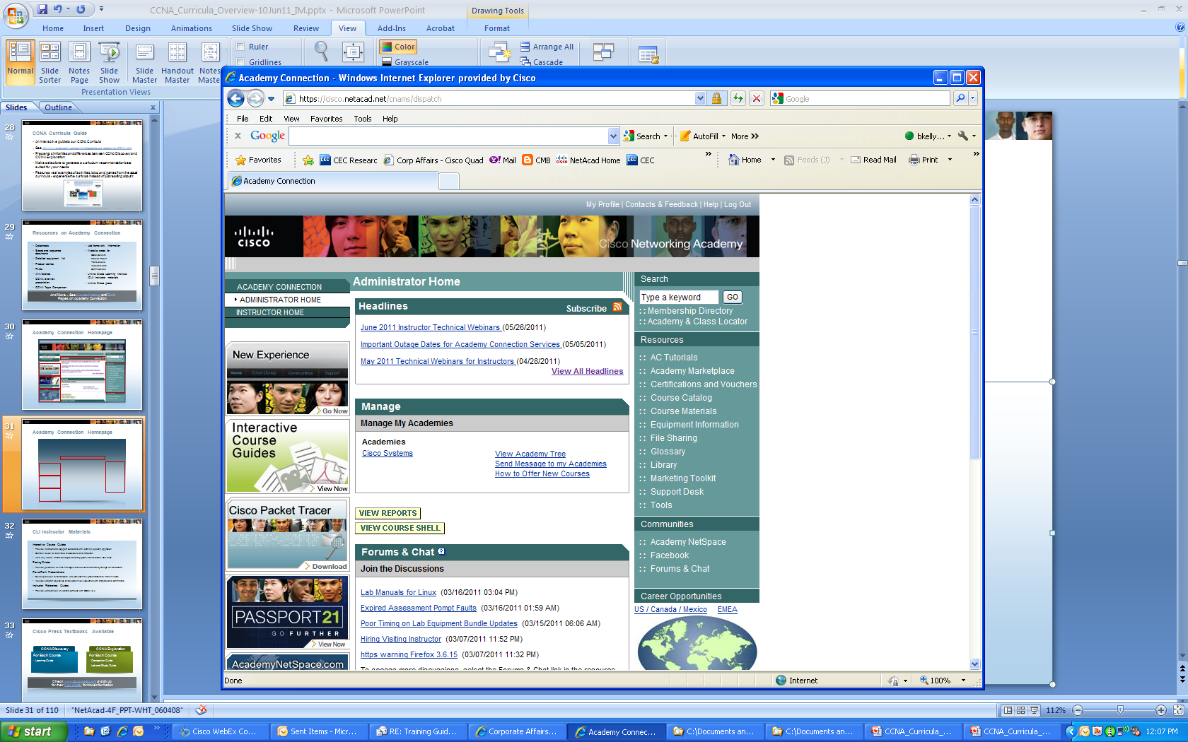
Academy Connection Homepage

Slide 31
Instructor Materials
Interactive Course Guides
Provide instructional support consistent with learning by doing approach
Contain ideas for activities, discussions, and reflection
Also key ideas, critical concepts, teaching goals, case studies, and tools
Pacing Guides
Provide guidance on time management and content difficulty ratings for instructors
PowerPoint Presentations
Building blocks for instructors, who can alter the presentations to fit their needs
Include chapter objectives and section-level objectives with graphics and summaries
Instructor Reference Guides
Provide comparison of existing curricula with CCNA v3.x

Slide 32
Cisco Press Textbooks Available
CCNA Discovery
CCNA Exploration
For Each Course
Learning Guide
Course Booklet
For Each Course
Companion Guide
Lab and Study Guide
Course Booklet
Check www.ciscopress.com or sign up for their Newsletter for more Information

Slide 33


Packet Tracer Simulation-Based Learning
What Is Packet Tracer?
Comprehensive networking technology simulation software
Powerful simulation, visualization, authoring, assessment, and collaboration capabilities
Design, Build, Configure, and Troubleshoot Networks Using Virtual Equipment
Allows practice outside of the physical classroom and lab
Supplements physical classroom equipment
Supports Lectures, Group and Individual Labs, Homework, Exams, Games, and Competitions
Helps Students Develop Critical 21st Century Skills
Problem solving, decision making, creative, and critical thinking
Notes:
Packet Tracer far more than just another network simulation tool, it is primarily a teaching and learning software application.

Slide 34
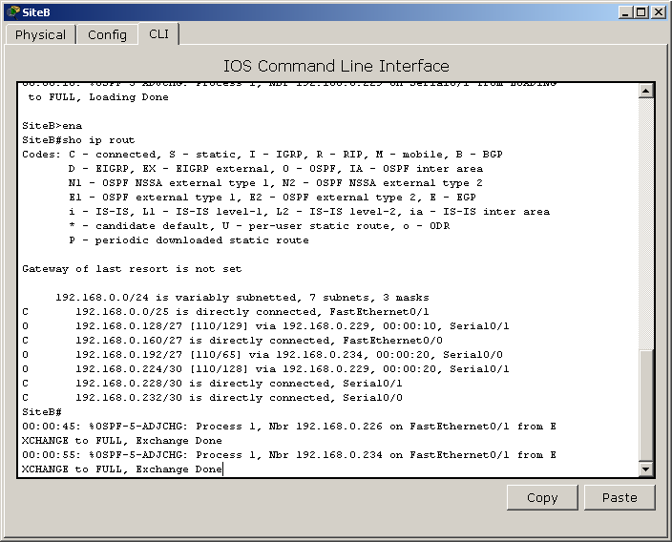
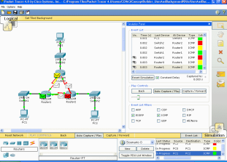
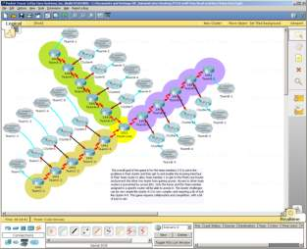
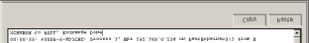

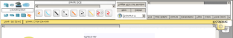
Simulation, Visualization, Collaboration
Simulate IOS Commands
Visualize Network Traffic
Collaborate on Multiuser Activities
Notes:
Innovative features of Packet Tracer help students and teachers collaborate, solve problems, and learn concepts in an engaging and dynamic social environment. Some of the benefits of Packet Tracer are as follows:
Provides a realistic simulation and visualization learning environment that supplements classroom equipment
Enables multiuser, real-time collaboration and competition for dynamic learning

Slide 35
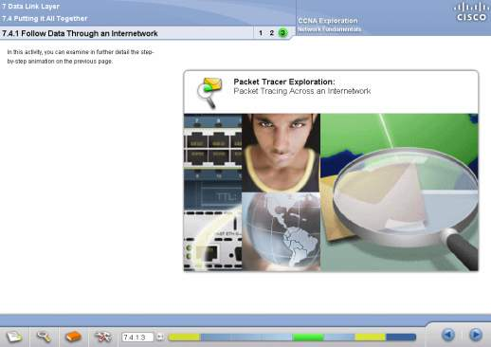
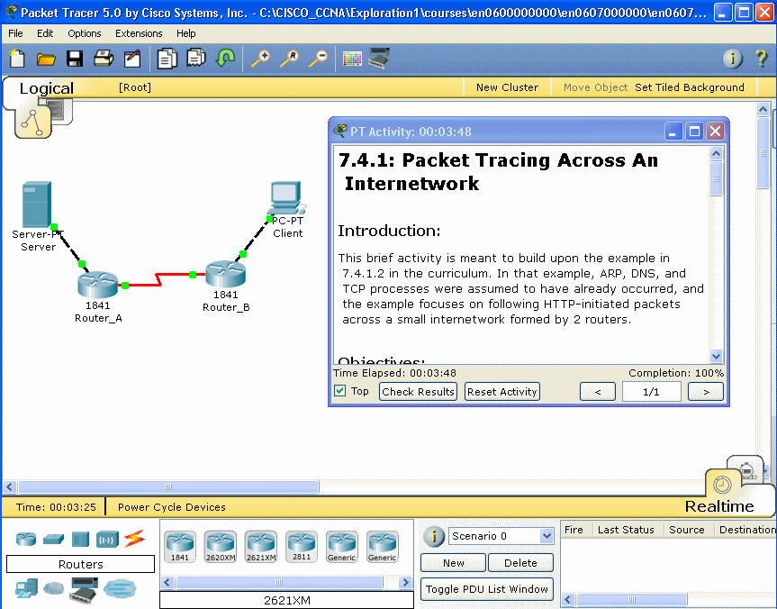

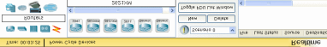
Integrated into CCNA Curricula
Students Launch Packet Tracer Directly From CCNA Discovery and CCNA Exploration to Access Activities That Reinforce the Curriculum
Notes:
Packet Tracer is a foundational teaching tool for CCNA Discovery and CCNA Exploration. Both curricula include embedded e-doing, which applies the principle that people learn best by interacting with computer-based activities. Interactive learning promotes the exploration of networking concepts and experimentation with tools such as Packet Tracer and Flash-based activities to help students develop a greater understanding of networking technologies. Packet Tracer activities are embedded in the course content.

Slide 36



Packet Tracer Skills Assessments Innovative New Assessment Offering
Authentic tasks, complex and performance based
Rich, immediate feedback
Online, centrally administered environment
Automatically scored and integrated with gradebook
Students practice in familiar simulation environment
Measures performance in addition to knowledge
Allows simultaneous testing for large numbers of students
Practice without accessing real equipment
Helps instill confidence in mastery of learned skills
21st century assessment integrated with networking technology curriculum
© 2010 Cisco Systems, Inc. All rights reserved.
Cisco Public
36
Notes:
36
The Networking Academy program has always emphasized the hands-on, “e-doing” aspect of learning, which re-enforces skills and helps students gain confidence that they can actually perform the tasks they have learned in the classroom.
Key features/benefits of Packet Tracer Skills Assessments include:
Authentic tasks, complex and performance based
Rich, immediate feedback
feedback helps students assess their mastery of critical networking skills and areas needing improvement
feedback helps instructors gauge teaching effectiveness
Online, centrally administered environment
Automatically scored and integrated with gradebook
Students practice in familiar Packet Tracer simulation environment used in the curriculum
Measures performance in addition to knowledge
Allows simultaneous testing for large numbers of students
Students can take practice exam without accessing real equipment
Students can use Packet Tracer Skills Assessments both inside and outside the classroom, to learn at their own pace, and at their own convenience (Internet connection required)
Helps instill confidence when preparing for the actual hands-on skills exam
Packet Tracer Skills Assessments are an innovative example of 21st century assessment integrated with networking technology curriculum

Slide 37


Practice Assessments for CCNA Courses
PT Practice Skills Based Assessments (SBAs) are the first Packet Tracer Skills Assessments available
Each CCNA course has a final hands-on skills exam
Administered on real equipment in person, or on remotely-accessed equipment
Assess ability to apply knowledge and perform real skills to succeed in the workforce
PT Practice SBAs provide a technology-based solution to practice for the final hands-on exam
Available for all CCNA Discovery & CCNA Exploration courses
Help indicate a student’s readiness for final hands-on exam
Note: PT Practice SBAs were designed to practice for the final summative skills exams on real equipment, not to replace them
© 2010 Cisco Systems, Inc. All rights reserved.
Cisco Public
37

Slide 38

CCNA Discovery Details

Slide 39

CCNA Discovery Course Sequence
The curriculum consists of four courses
Networking for Home and Small Businesses has no prerequisites
The courses are taken sequentially
Networking for Home and Small Businesses
Working at a Small-to-Medium Business or ISP
Introducing Routing and Switching in the Enterprise
Designing and Supporting Computer Networks

Slide 40
CCNA Discovery Course Outline
Chapter | Networking for Home and Small Businesses | Working at a Small-to-Medium Business or ISP | Introducing Routing and Switching in the Enterprise | Designing and Supporting Computer Networks
1 | Personal Computer Hardware | The Internet and Its Uses | Networking in the Enterprise | Introducing Network Design Concepts
2 | Operating Systems | Help Desk | Exploring the Enterprise Network Infrastructure | Gathering Network Requirements
3 | Connecting to the Network | Planning a Network Upgrade | Switching in an Enterprise Network | Characterizing the Existing Network
4 | Connecting to the Internet Through an ISP | Planning the Addressing Structure | Addressing in a Enterprise Network | Identifying Application Impacts on Network Design
5 | Network Addressing | Configuring Network Devices | Routing with a Distance Vector Protocol | Creating the Network Design
6 | Network Services | Routing | Routing with a Link-State Protocol | Using IP Addressing in the Network Design
7 | Wireless Technologies | ISP Services | Implementing Enterprise WAN Links | Prototyping the Campus Network
8 | Basic Security | ISP Responsibility | Filtering Traffic Using Access Control Lists | Prototyping the WAN
9 | Troubleshooting Your Network | Preparing for Certification | Troubleshooting an Enterprise Network | Preparing the Proposal
10 | Course Summary: Putting It All Together | Course Summary: Putting It All Together | Course Summary: Putting It All Together | Course Summary: Putting It All Together

Slide 41


CCNA Discovery:
Networking for Home and Small Businesses
Overview
This course teaches students the skills needed to obtain entry-level home network installer jobs. It also helps students develop some of the skills needed to become network technicians, computer technicians, cable installers, and help desk technicians
It provides a hands-on introduction to networking and the Internet using tools and hardware commonly found in home and small business environments
Instructors are encouraged to facilitate field trips and outside-the-classroom learning experiences
Labs include PC installation, Internet connectivity, wireless connectivity, file and print sharing, and the installation of game consoles, scanners, and cameras
Prerequisites: None

Slide 42
CCNA Discovery:
Networking for Home and Small Businesses
Chapter | Objectives
1. Personal Computer Hardware | Describe the Use of Computers, Components, Peripherals, and Network and Local Applications
2. Operating Systems | Describe the Purpose, Use and Maintenance of Operating Systems
3. Connecting to the Network | Describe Network Operations and Implement a Local Area Network
4. Connecting to the Internet Through an ISP | Describe the Purpose and Function of an Internet Service Provider
5. Network Addressing | Describe IP Addressing and IP Address Management
6. Network Services | Describe the Client/Server Relationship, Associated Applications and Protocols, and Explain the OSI Model
7. Wireless Technologies | Describe and Implement a Wireless Network
8. Basic Security | Describe Migration Techniques for Security Risks
9. Troubleshooting Your Network | Describe the Troubleshooting Process and Troubleshoot Common Network Issues

Slide 43


CCNA Discovery:
Working at a Small-to-Medium Business or ISP
Overview
This course prepares students for jobs as network technicians and helps them develop additional skills required for computer technicians and help desk technicians. It provides a basic overview of routing and remote access, addressing, and security
It also familiarizes students with servers that provide email services, web space, and authenticated access
Students learn about the soft skills required for help desk and customer service positions, and the final chapter helps them prepare for the CCENT certification exam
Network monitoring and basic troubleshooting skills are taught in context
Prerequisites: Networking for Home and Small Businesses

Slide 44
CCNA Discovery:
Working at a Small-to-Medium Business or ISP
Chapter | Objectives
1. The Internet and Its Uses | Describe the Hierarchy of Connection Providers to the Internet
2. Help Desk | Describe Procedures to Resolve or Escalate Problems at the ISP
3. Planning a Network Upgrade | Prepare For The Installation Of A Network Upgrade
4. Planning the Addressing Structure | Describe How the IP Address Is Used in Communication and Develop an IP Addressing Scheme
5. Configuring Network Devices | Configure Network Devices for a Local Area Network
6. Network Services | Describe the Purpose and Function of Dynamic Routing and the Protocols Used to Implement It
7. Routing | Describe Common ISP Services and Their Protocols
8. ISP Services | Describe the Role and Responsibility of the ISP in Maintenance, Security, and Recovery
9. Troubleshooting | Troubleshoot a Network Using the OSI Model and Prepare for the Certification Exam

Slide 45

CCNA Discovery:
Introducing Routing and Switching in the Enterprise
Overview
This course familiarizes students with the equipment applications and protocols installed in enterprise networks, with a focus on switched networks, IP telephony requirements, and security
It also introduces advanced routing protocols such as Enhanced Interior Gateway Routing Protocol (EIGRP) and Open Shortest Path First (OSPF) Protocol
Hands-on exercises, including configuration, installation, and troubleshooting, reinforce student learning
Prerequisites: Working at a Small-to-Medium Business or ISP

Slide 46
CCNA Discovery:
Introducing Routing and Switching in the Enterprise
Chapter | Objectives
1. Networking in the Enterprise | Describe an Enterprise Network and the Types of Data Flow That May Be Encountered in an Enterprise Network
2. Exploring the Enterprise Network Infrastructure | Describe the Structure of the Enterprise Network and How Services Are Provided to the Edge
3. Switching in an Enterprise Network | Describe and Configure Switches for the Enterprise Network
4. Addressing in an Enterprise Network | Describe and Develop and IP Addressing Scheme for the Enterprise Network, Including Use of Variable Length Subnet Masks, Classless Interdomain Routing, Route Aggregation, and Summarization
5. Routing with a Distance Vector Protocol | Describe and Implement Distance Vector Routing Protocols, As Well As Static and Default Routes
6. Routing with a Link-State Protocol | Describe and Implement Link State Routing Protocols and Route Redistribution
7. Implementing Enterprise WAN Links | Describe and Configure Common WAN Encapsulation Protocols
8. Filtering Traffic Using Access Control Lists | Describe and Configure Standard, Extended, and Named Acls
9. Troubleshooting an Enterprise Network | Describe the Concept of a Failure Domain and Troubleshoot Enterprise Connectivity Issues

Slide 47


CCNA Discovery:
Designing and Supporting Computer Networks
Overview
This course introduces students to network design processes using two examples; a large stadium enterprise network and a medium-sized film company network; students follow a standard design process to expand and upgrade each network, which includes requirements gathering, proof-of-concept, and project management
Lifecycle services, including upgrades, competitive analyses, and system integration, are presented in the context of presale support
In addition to the packet tracer and lab exercises found in the previous courses, there are many pen-and-paper and role-playing exercises that students complete while developing their network upgrade proposals
Prerequisites: Introducing Routing and Switching in the Enterprise

Slide 48
CCNA Discovery:
Designing and Supporting Computer Networks
Chapter | Objectives
1. Introducing Network Design Concepts | Describe the Benefits of a Hierarchical Network Design and Explain Design Considerations for Specific Areas of the Network
2. Gathering Network Requirements | Describe the Six Phases of PPDIOO Model and Based on Business Goals Determine Technical Requirements for a Network Upgrade
3. Characterizing the Existing Network | Develop a Detailed Network Design Requirements Document Based on Existing Network Implementation and Technical Requirements
4. Identifying Application Impacts on Network Design | Describe the Characteristics of Various Network Applications and How Incorporating Those Applications Affects Network Design
5. Creating the Network Design | Design the Core, Distribution, and Access Layers for a Campus Network and Incorporate WAN and Remote Worker Connectivity
6. Using IP Addressing in the Network Design | Select a Hierarchical IP Addressing Scheme, Routing Protocol, and Naming Structure for a Campus Network
7. Prototyping the Campus Network | Develop a Test Plan and Based on Results, Identify Risks and Weaknesses in the Network Design
8. Prototyping the WAN | Describe and Configure WAN Connectivity for Remote Sites and Remote Workers
9. Preparing the Proposal | Develop and Present a Network Upgrade Proposal to Include an Implementation Schedule and Cost Summary

Slide 49
CCNA Discovery
Instructional Methodology
Skill | Networking for Home or Small Businesses | Working at a Small-to-Medium Business or ISP | Introducing Routing and Switching in the Enterprise | Designing and Supporting Computer Networks
Routing | Routing Table Operation | Introduce Protocols; Configure Routes and Routers | Configure VLAN, RIPv2, EIGRP, OSPF | Design, Configure, and Test EIGRP and OSPF
Switching | Introduce and Practice Broadcast Domain, Switch Operation, MAC Address Table Concepts | Configure Switch Management Interface and Port Security, Configure and Connect Switches | Configure VLAN Membership, Spanning Tree, 802.1q Trunking Operation | Design and Prototype Access Layer Switched Network, Configure, and Verify Switch Operations
Addressing | Implement IP Addressing, DHCP Configuration, and NAT Operation | Introduce and Practice Subnets, Classless IP Addressing and Routing, VLSM, Subnetting Methods, IPv6 | Reinforce VLSM, Introduce Route Summarization and Aggregation | Review and Expand IPv6; IP Addressing Design and Configuration
ACLs |  | Introduce ACLs | Verify, Implement, and Troubleshoot ACLs in the Enterprise | Review ACLs and Use to Incorporate Security in a Branch Office Network
Notes:
Layering of topics from Course 1 through 4

Slide 50
CCNA Discovery Soft Skills
Networking for Home and Small Businesses
Working at a Small-to-Medium Business or ISP
Introducing Routing and Switching in the Enterprise
Designing and Supporting Computer Networks
Communications
Active listening with customers
Describing technical concepts to non-technical users
Basic troubleshooting
Documentation
Purchasing
Communications
Active listening with customers
Describing technical concepts to non-technical users
Advanced troubleshooting
Documentation
Time Management
Professionalism
Teamwork
Problem solving
Advanced troubleshooting
Critical thinking
Career planning
Advanced troubleshooting
Interviewing
Critical thinking
Requirements gathering
Business case
Developing proposal
Estimating
Presentation
Project planning
Notes:
This slide lists the soft skills incorporated into the CCNA Discovery curricula
CCNA Discovery and CCNA Exploration integrate real-world skills into the technical curricula to create a learning experience for success in the 21st century global workplace. The online learning environment provides ample opportunities for self-paced and self-directed learning, reinforcing these necessary skills.
Students not only learn the fundamentals of designing, building, and operating networks, they also learn about problem solving, critical thinking, collaboration and teamwork, and negotiation - skills they can apply in their future education and on the job.

Slide 51
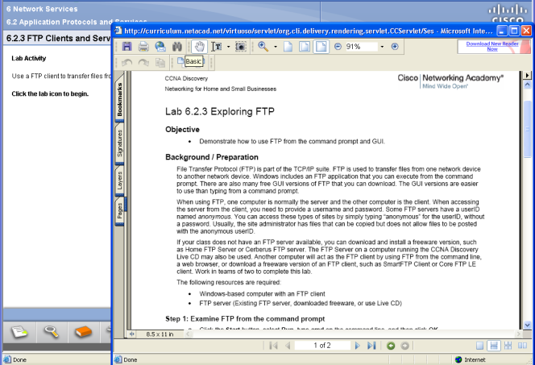

Lab Activities
The course includes lab activities that allow students to visualize and have hands-on experience with the network services introduced in the course

Slide 52
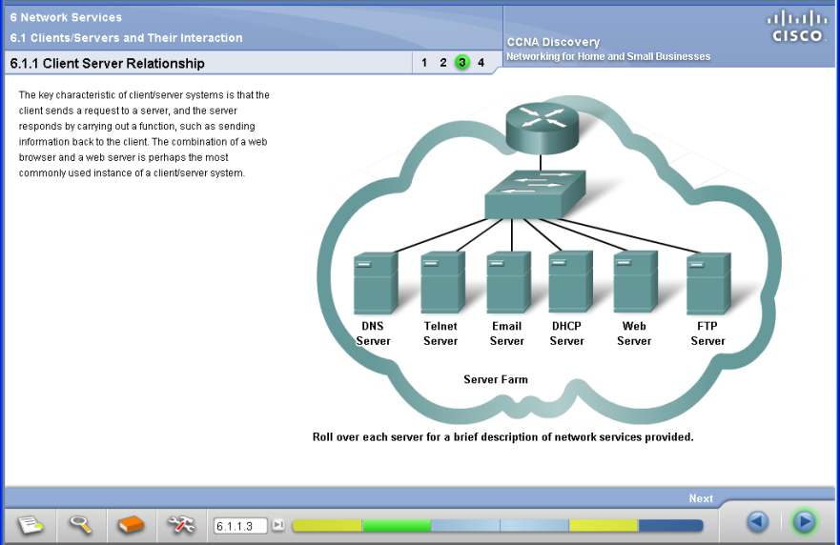
Example of Network Services

Slide 53
CCNA Discovery Server
Software that provides network services in an isolated lab environment, disconnected from the Internet
No additional hardware or equipment required
Required to complete many of the CCNA Discovery labs
Offers great flexibility to enrich the learning experience
Network services provided
DNS
Web server
FTP
Telnet
SSH
DHCP
Detailed instructions, FAQs, and Discovery Server software can be downloaded from Academy Connection Tools page

Slide 54
CCNA Exploration Details

Slide 55



CCNA Exploration Course Sequence
The curriculum consists of four courses
Network Fundamentals is the first course and has no prerequisites
The curriculum then offers flexibility in delivery
Network Fundamentals
Network Fundamentals
Network Fundamentals
Routing Protocols and Concepts
LAN Switching and Wireless
Routing Protocols and Concepts
LAN Switching and Wireless
LAN Switching and Wireless
Routing Protocols and Concepts
Accessing the WAN
Accessing the WAN
Accessing the WAN
Notes:
Here are examples of how the four CCNA Exploration courses can be offered, providing greater flexibility in course delivery.
Network Fundamentals is the first course and it has no prerequisites. It is a prerequisite for the other three courses.
Routing Protocols and Concepts is the preferred second course in the sequence, but variations are possible.
The diagram on the right shows the possibility of offering the LAN Switching and Wireless course before the Routing Protocols and Concepts course.
The diagram in the middle shows how courses can be offered simultaneously. By doing this, an academy can reduce the duration of the full cycle by at least 25 percent.
The diagram illustrates the possibility of offering the Routing Protocols and Concepts course and the LAN Switching and Wireless course at the same time.
It is highly recommended to teach Routing Protocols and Concepts prior to Accessing the WAN.

Slide 56
CCNA Exploration Course Outline
Chapter | Network Fundamentals | Routing Protocols and Concepts | LAN Switching and Wireless | Accessing the WAN
1 | Living in a Network Center World | Introduction to Routing and Packet Forwarding | LAN Design | Services in a Converged WAN
2 | Communicating over the Network | Static Routing | Configure a Switch | PPP
3 | Application layer functionality and Protocols | Introduction to Dynamic Routing Protocols | VLANs | Frame Relay
4 | OSI Transport Layer | Distance Vector Routing Protocols | Implement VTP | Network Security
5 | OSI Network Layer | RIP version 1 | Implementing Spanning Tree Protocols | Access Control Lists (ACLs)
6 | Addressing the Network-IPv4 | VLSM and CIDR | Implementing Inter-VLAN Routing | Providing Teleworker Services
7 | Data Link Layer | RIPv2 | Configuring a Wireless Router | Implementing IP Addressing Services
8 | OSI Physical Layer | The Routing Table: A Closer Look |  | Troubleshooting Networks
9 | Ethernet | EIGRP
10 | Planning and Cabling Networks | Link-State Routing Protocols
11 | Configuring and Testing your Network | OSPF

Slide 57

CCNA Exploration:
Network Fundamentals
Overview
This course introduces the architecture, structure, functions, components, and models of the Internet and other computer networks
It uses the OSI and TCP layered models to examine the nature and roles of protocols and services at the application, network, data link, and physical layers
Principles and structure of IP addressing and the fundamentals of Ethernet concepts, media, and operations are introduced to provide a foundation
Labs use a “model Internet” to allow students to analyze real data without affecting production networks. Packet Tracer activities help students analyze protocol and network operation and build small networks in a simulated environment
Students build simple LAN topologies by applying basic principles of cabling, performing basic configurations of network devices such as routers and switches, and implementing IP addressing schemes
Prerequisites: None

Slide 58
CCNA Exploration:
Network Fundamentals
Chapter | Objectives
1. Living in a Network Center World | Understand How Data Networks Support Business and Personal Communications
2. Communicating over the Network | Describe the Structure of a Network and the Function of Protocols in Network Communications
3. Application Layer Functionality and Protocols | Describe the Function of Well-Known TCP/IP Applications and Their Related Services and Protocols
4. OSI Transport Layer | Explain the Role and Functionality of the Transport Layer Protocols
5. OSI Network Layer | Explain the Role and Features of the Internet Protocol (IP); Understand the Fundamentals of Routing and Packet Forwarding
6. Addressing the Network—IPv4 | Understand the Need and Structure of IP Addressing; Generate and Assign Addresses to Networks and Network Devices
7. Data Link Layer | Explain the Role of Data Link Layer Protocols in Data Transmission; Describe the Layer 2 Frame and Key Frame Fields
8. OSI Physical Layer | Understand the Functions of the Physical Layer and Its Standards and Protocols
9. Ethernet | Describe the Ethernet Protocol and the Physical and Data Link Layer Features of Ethernet; Compare and Contrast Ethernet Hubs and Switches
10. Planning and Cabling Networks | Identify and Select the Cables, Standards, and Ports Used for LAN and WAN Connections; Design an Addressing Scheme for an Internetwork; Compare Network Designs
11. Configuring and Testing Your Network | Define the Role of the Internetwork Operating System (IOS); Identify the IOS Modes of Operation and Basic IOS Commands

Slide 59


CCNA Exploration:
Routing Protocols and Concepts
Overview
This course describes the architecture, components, and operation of routers, and explains the principles of routing and routing protocols
Students analyze, configure, verify, and troubleshoot the primary routing protocols RIPv1, RIPv2, EIGRP, and OSPF
By the end of this course, students will be able to recognize and correct common routing issues and problems
Students complete a basic procedural lab, followed by basic configuration, implementation, and troubleshooting labs in each chapter
Packet Tracer activities reinforce new concepts, and allow students to model and analyze routing processes that may be difficult to visualize or understand
Prerequisites: Network Fundamentals

Slide 60
CCNA Exploration:
Routing Protocols and Concepts
Chapter | Objectives
1. Introduction to Routing and Packet Forwarding | Introduce the Router’s Role, Its Main Hardware and Software Components, and the Packet Forwarding Process
2. Static Routing | Explain the Role and Configuration of Static Routes; Introduce the Routing Table; Verify Route Entries As They Are Added and Deleted Form the Routing Table
3. Introduction to Dynamic Routing Protocols | Overview Routing Protocol Concepts and Dynamic Routing Protocols
4. Distance Vector Routing Protocols | Examine Distance Vector Concepts and Operations Including Network Discovery and Routing Table Maintenance
5. RIPv1 | Examine the Characteristics, Operations, and Limitations of Ripv1; Configure, Verify, and Troubleshoot Ripv1
6. VLSM and CIDR | Explore the Role and Benefits of VLSM and CIDR; Introduce Classless Routing Protocols
7. RIPv2 | Discuss the Limitations of Classful Protocols and Ripv1; Introduce Ripv2 and Benefits of Classless Protocols; Configure, Verify, and Troubleshoot Ripv2
8. The Routing Table: A Closer Look | Examine the Routing Table Process and How It Determines the Best Route for a Packet; Understand the Difference Between Classful and Classless Routing
9. EIGRP | Examine the Advantages and Operation of EIGRP; Configure, Verify, and Troubleshoot EIGRP
10. Link-State Routing Protocols | Examine Link-State Routing Protocol Concepts, Algorithm and Routing Process; Discuss Benefits and Advantages Over Distance Vector Protocols
11. OSPF | Examine the Operation of OSPF (Open Shortest Path First); Configure, Verify, and Troubleshoot OSPF

Slide 61

CCNA Exploration:
LAN Switching and Wireless
Overview
This course provides a comprehensive, theoretical, and practical approach to learning the technologies and protocols needed to design and implement a converged switched network
Students learn about the hierarchical network design model and how to select devices for each layer
The course explains how to configure a switch for basic functionality and how to implement virtual LANs, VTP, and inter-VLAN routing in a converged network
The different implementations of Spanning Tree Protocol in a converged network are presented, and students develop the knowledge and skills necessary to implement a WLAN in a small-to-medium network
Prerequisites: Network Fundamentals

Slide 62
CCNA Exploration:
LAN Switching and Wireless
Chapter | Objectives
1. LAN Design | Explain the Functions of Hierarchical Network Design So That You Can Select Appropriate Devices for a LAN Environment
2. Configure a Switch | Configure a Switch for Basic Functionality in a Converged Network
3. VLANs | Implement Virtual LANs in a Converged Network
4. Implement VTP | Implement the VLAN Trunking Protocol in a Converged Network to Assist in the Administration of Vlans
5. Implementing Spanning Tree Protocols | Implement Rapid Spanning Tree in a Converged Network in Order to Prevent Loops Between Redundant Switches
6. Implementing Inter-VLAN Routing | Implement Inter-VLAN Routing Between VLANS
7. Configuring a Wireless Router | Explain the Appropriate Administrative Tasks Required for WLAN and Install a Small Wireless Network

Slide 63

CCNA Exploration:
Accessing the WAN
Overview
This course discusses the WAN technologies and network services required by converged applications in enterprise networks
The course uses the Cisco Network Architecture to introduce integrated network services and explains how to select the appropriate devices and technologies to meet network requirements
Students learn how to implement and configure common data link protocols and how to apply WAN security concepts, principles of traffic, access control, and addressing services
Finally, students learn how to detect, troubleshoot, and correct common enterprise network implementation issues
Prerequisites: Network Fundamentals, Routing Protocols and Concepts, and LAN Switching and Wireless

Slide 64
CCNA Exploration
Accessing the WAN
Chapter | Objectives
1. Services in a Converged WAN | Select the Appropriate WAN Technology to Provide Integrated Services Over a Network
2. PPP | Implement PPP Serial Communication to Provide WAN Services Over a Network
3. Frame Relay | Implement Frame Relay Technology to Provide WAN Services Over a Network
4. Network Security | Describe the Common Security Threats to Networks and the General Methods to Mitigate Those Threats
5. Access Control Lists (ACLs) | Implement, Verify, and Troubleshoot ACLs in a Medium-Sized Branch Office Network
6. Providing Teleworker Services | Describe How to Use VPN Technology to Provide Secure Teleworker Services to a Network
7. Implementing IP Addressing Services | Implement IP Addressing Services for a Network
8. Troubleshooting Networks | Troubleshoot Common Network Implementation Issues

Slide 65
CCNA Exploration
Instructional Methodology
Skill | Network Fundamentals | Routing Protocols and Concepts | LAN Switching and Wireless | Accessing the WAN
Routing | Introduces IP Protocol, IP Addressing and Concept of Routing; Basic Cisco IOS® Commands to Configure Router and Router Interfaces; Explore Routing Tables | Focuses on Routing and Routers; Teaches Details on How to Configure, Verify, and Troubleshoot Multiple Routing Protocols, Including RIPv1 and v2, EIGRP, OSPF, and BGP
Switching | Concepts of Ethernet, Switching, and Switches; Services Offered by the Data Link Layer; Basic Cisco IOS Commands Used in Switches |  | Technologies and Protocols to Design and Implement a Converged Switched Network; Configure a Switch for Basic Functionality; Configure, Certify, and Troubleshoot Virtual LANs, VTP, and Inter-VLAN Routing; Implement Spanning Tree (IEEE 802.1D, PVST+, RSTP, PVRST+) | WAN Technologies and Devices Required for Network and Internet Communications; Implement Data Link Protocols Including PPP, ATM, Ethernet, Frame Relay, HDLC
Addressing | Network Addressing; Assign IP Addresses to Network and Devices; Classfull and Classless Addresses; Use of the Network Mask and the Prefix Length; Concept of VLSM | Detail Review of the Concepts of Classless Interdomain Routing (CIDR) and Variable Subnet Masking (VLSM) |  | Implement IP Addressing Services for an Enterprise Network, Including NAT and DHCP; IPv6 Addressing Concepts; Use of Cisco SDM to Implement IP Addressing Services and ACLs
Other | Application and Transport Protocols; Interaction of Protocols Services and Applications; Design, Cable, Connect, and Configure a Small Network Using Basic Cisco IOS Commands for Routers and Switches |  | Components of Operation of Wireless LANs (WLANs); Configure, Verify, and Troubleshoot Basic WLAN Access and Security | Implement VPN; Analyze Network Vulnerabilities and Implement Security Technologies…Implement ACLs for Traffic Control Detect, Troubleshoot, and Correct Common Enterprise Network Implementation Issues

Slide 66
CCNA Exploration Soft Skills
Network Fundamentals
Routing Protocols and Concepts
LAN Switching and Wireless
Accessing the WAN
Basic planning and design
Troubleshooting
Basic planning and design
Troubleshooting
Basic planning and design
Requirements gathering
Documentation
Troubleshooting
Critical thinking
Customer communications
Notes:
This slide lists the soft skills incorporated into the CCNA Exploration curricula
CCNA Discovery and CCNA Exploration integrate real-world skills into the technical curricula to create a learning experience for success in the 21st century global workplace. The online learning environment provides ample opportunities for self-paced and self-directed learning, reinforcing these necessary skills.
Students not only learn the fundamentals of designing, building, and operating networks, they also learn about problem solving, critical thinking, collaboration and teamwork, and negotiation - skills they can apply in their future education and on the job.

Slide 67
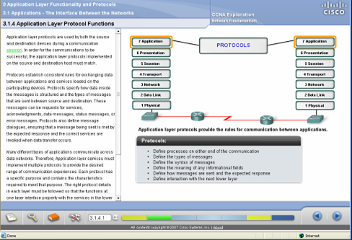
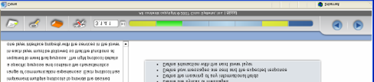
Top Down Approach
Following a top down approach to teaching Networking, CCNA Exploration introduces applications and application services very early in the course
The course explains the role and nature of the main application protocols and their relation to protocols and services provided to them by the lower layers of the network

Slide 68
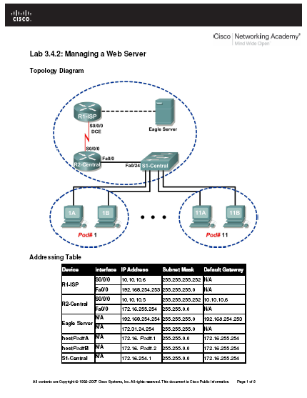
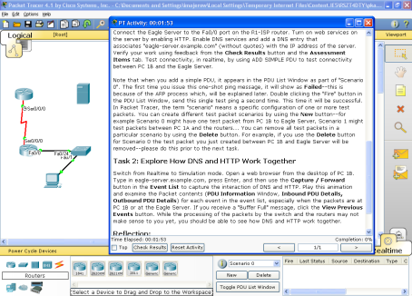


Labs and Packet Tracer Activities
The course includes an important number of labs and Packet Tracer Activities that allow students to visualize and have hands-on experience with the application protocols and services introduced in the course

Slide 69
CCNA Eagle Server
Software that provides network services and applications in an isolated lab environment, disconnected from the Internet
No additional hardware or equipment required
Required to complete most of the CCNA Exploration labs
Offers great flexibility to enrich the learning experience
Network services provided
DNS
Web Server
FTP
TFTP
SSH
Instant messaging
Wiki server
Email
Detailed instructions, FAQs and CCNA Eagle Server software can be downloaded from Academy Connection Tools page

Slide 70

Instructor Training

Slide 71
Instructor Training
In person training, approximately 40 classroom hours per course
OR
Fast Track option
CCNA or higher certification, formal evidence of industry experience, or formal evidence of CCNA teaching experience required
Fast Track completion requirements include:
Skills-based assessment
Case study
Completion must be done in a proctored environment
Instructors enroll in Fast Track through the Help Desk

Slide 72


In-Person Training for CCNA Curricula
Register for training on Academy Connection
Attend scheduled training at Training Center
Focuses on main ideas, strategies for teaching difficult concepts, and connection with real world scenarios
Uses the actual curriculum and Interactive Course Guide (ICG)
Interactive sessions for skills-based training
Complete course exam and skills exam

Slide 73
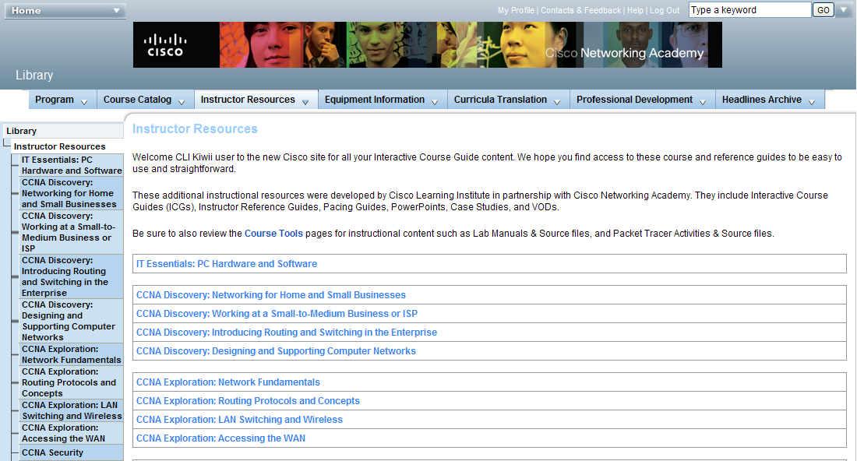
Instructor Training Resources Available

Slide 74
Instructor Pacing Guide
Available per course for CCNA Discovery and CCNA Exploration
Currently in English only
Provide guidance on time management and content difficulty ratings for each chapter
Helps instructors identify course content that may be difficult to teach and may also be difficult for students to grasp.
Suggests the percentage of time to be spent on each chapter, based on 2-month and 4-month teaching cycles
Recommends a minimum percentage of time that should be spent on lab activities within each chapter
This assumes that instructors will use the remaining time outside of lab activities on teaching, reading, discussion, and assessment
Available on the Kiwii instructor resources site
Click the CLI Interactive Course Guides link on the Academy Connection Instructor Home page or from the Tools section on Academy Connection

Slide 75
Interactive Course Guide
Available per course for CCNA Discovery and CCNA Exploration (currently in English only)
Key ideas
Teaching goals
Critical concepts
How to teach concepts
Discussion ideas
Reflection
Case studies, labs, videos, tools

Slide 76
Academy Connection: Curriculum Prerequisites

Slide 77
CCNA Discovery
Academy Connection System Prerequisites for Enrollment
 | Networking for Home and Small Businesses | Working at a Small-to-Medium Business or ISP | Introducing Routing and Switching in the Enterprise | Designing and Supporting Computer Networks
Students (Prereqs for enrollment) | None, but recommend that student have basic PC usage skills | CCNA 1 v3.1 OR Networking for Home and Small Business OR Networking Fundamentals | CCNA 2 v3.1 OR Working at a Small-to-Medium Business or ISP | Introducing Routing and Switching in the Enterprise OR Accessing the WAN

Slide 78
CCNA Discovery
Academy Connection System Prerequisites for Teaching
 | Networking for Home and Small Businesses | Working at a Small-to-Medium Business or ISP | Introducing Routing and Switching in the Enterprise | Designing and Supporting Computer Networks
Instructors (Prereqs to teach student class) | CCNA 2 v3.1 AND Orientation OR Networking for Home and Small Businesses AND Orientation OR Networking Fundamentals AND Orientation OR Accessing the WAN AND Orientation OR Designing and Supporting Computer Networks AND Orientation OR CCNA 4 v 3.1 AND Orientation OR (CCNA Discovery OR CCNA Exploration Fast Track) AND Orientation | CCNA 2 v3.1 AND Orientation OR Working at a Small-to-Medium Business or ISP AND Orientation OR Routing Protocols and Concepts AND LAN Switching and Wireless AND Orientation OR Accessing the WAN AND Orientation OR Designing and Supporting Computer Networks AND Orientation OR CCNA 4 v3.1 AND Orientation OR (CCNA Discovery OR CCNA Exploration Fast Track) AND Orientation | CCNA 3 v3.1 AND Orientation OR Introducing Routing and Switching in the Enterprise AND Orientation OR Routing Protocols and Concepts AND LAN Switching and Wireless AND Orientation OR Accessing the WAN AND Orientation OR Designing and Supporting Computer Networks AND Orientation OR CCNA 4 v3.1 AND Orientation OR (CCNA Discovery OR Exploration Fast Track) AND Orientation | CCNA 4 v3.1 AND Orientation OR Designing and Supporting Computer Networks AND Orientation OR Accessing the WAN AND Orientation OR (CCNA Discovery OR CCNA Exploration Fast Track) AND Orientation

Slide 79
CCNA Exploration
Academy Connection System Prerequisites for Enrollment
 | Networking Fundamentals | Routing Protocols and Concepts | LAN Switching and Wireless | Accessing the WAN
Students (Prereqs for enrollment) | None, but recommend that student have advanced analytical and problem solving skills | CCNA 1 v3.1 OR Networking Fundamentals OR Networking for Home and Small Businesses AND Working at a Small-to-Medium Business or ISP | CCNA 1 v3.1 OR Networking Fundamentals OR Networking for Home and Small Businesses AND Working at a Small-to-Medium Business or ISP | CCNA 3 v3.1 OR CCNA 1 v.3.1 AND CCNA 2 v3.1 AND LAN Switching and Wireless OR Routing Protocols and Concepts AND LAN Switching and Wireless

Slide 80
CCNA Exploration
Academy Connection System Prerequisites for Teaching
 | Networking Fundamentals | Routing Protocols and Concepts | LAN Switching and Wireless | Accessing the WAN
Instructors (Prereqs to teach student classes) | CCNA 2 v3.1 AND Orientation OR Working at a Small-to-Medium Business or ISP AND Orientation OR Networking Fundamentals AND Orientation OR Designing and Supporting Computer Networks AND Orientation OR Accessing the WAN AND Orientation OR CCNA 4 v 3.1 AND Orientation OR (CCNA Discovery OR CCNA Exploration Fast Track) AND Orientation | CCNA 2 v3.1 AND Orientation OR Introducing Routing and Switching in the Enterprise AND Orientation OR Routing Protocols and Concepts AND Orientation OR Designing and Supporting Computer Networks AND Orientation OR Accessing the WAN AND Orientation OR CCNA 4 v3.1 AND Orientation OR (CCNA Discovery OR CCNA Exploration Fast Track) AND Orientation | CCNA 3 v3.1 AND Orientation OR Introducing Routing and Switching in the Enterprise AND Orientation OR LAN Switching and Wireless AND Orientation OR Designing and Supporting Computer Networks AND Orientation OR Accessing the WAN AND Orientation OR CCNA 4 v3.1 AND Orientation OR (CCNA Discovery OR CCNA Exploration Fast Track) AND Orientation | CCNA 4 v3.1 AND Orientation OR Designing and Supporting Computer Networks AND Orientation OR Accessing the WAN AND Orientation OR CCNA 4 v3.1 AND Orientation OR (CCNA Discovery OR CCNA Exploration Fast Track) AND Orientation

Slide 81

Translated and Accessible Versions

Slide 82
Improving Student Outcomes
We are committed to making our courses and documentation accessible and usable by all students to help them achieve their goals
Translation of the CCNA curricula improves student outcomes by facilitating learning success on a global scale
Accessible versions of all courses provide access to CCNA Discovery and CCNA Exploration for students with accessible needs—including those with visual, auditory, and dexterity limitations

Slide 83
Cisco Networking Academy
Translation Framework
Globally Strategic
Led by Cisco Corporate
Regionally Strategic
Led by Cisco Field or Partner
Locally Strategic
Led by Cisco Field or Partner
Category
High Networking Academy market potential
High demand for skilled people (IDC)
Alignment with cert priorities
Networking Academy global alignment
Moderate market potential
Moderate demand for skilled people
Alignment with certification priorities and partner goals
Networking Academy theater alignment
Networking Academy country alignment
Alignment with partner goals
Criteria
Six UN Languages
Prioritized Installed Base + Theater Priorities
Examples
Examples
Arabic
English
French
Russian
Simplified Chinese
Spanish
Hungarian
Turkish
Korean
Romanian
Languages
Br. Portuguese
German
Japanese
Polish
Tr. Chinese
Notes:
Many factors contributed to the translation strategy for our CCNA curricula. We have broken them into the three categories of globally, regionally, and locally strategic.
The Globally Strategic category is driven by Cisco corporate.
Translation of the CCNA curricula improves student outcomes by facilitating learning success on a global scale.
Our CCNA translation strategy is focused on the following 5 United Nations (UN) languages: English, French, Russian, Simplified Chinese, and Spanish.

Slide 84


Collaborative Global Community
Currently Available Languages
UN Languages
CCNA Discovery
Arabic, French, Russian, Simplified Chinese, Spanish
CCNA Exploration
French, Simplified Chinese, Spanish
Non-UN Languages
CCNA Discovery
German, Hungarian, Japanese, Portuguese, Polish, Romanian, Turkish
CCNA Exploration
Brazilian Portuguese, Korean, Polish, Traditional Chinese
Notes:
84
CCNA Discovery is currently available in English, French, Russian, Simplified Chinese, and Spanish, and CCNA Exploration is currently available in English, French, Simplified Chinese, and Spanish.
The courses are also available in a number of other languages through contributions by Cisco Networking Academy partners and the academy community.

Slide 85
Translated Teaching Resources
Translated instructor materials available on the Tools page of Academy Connection for all translated CCNA courses
Scope and Sequence
Instructor and Student Lab Manual
Student Packet Tracer Lab Manual
Lab source files
Discovery Server and Exploration Server documents (Classroom Set Up Tab)
In addition, the following instructor training materials are available in Spanish
Interactive Course Guides (ICGs)
Instructor Reference Guide (IRGs)
PowerPoint teaching aid presentations

Slide 86

Equipment Requirements and Recommendations

Slide 87
CCNA Curricula Equipment Requirements
The minimum required lab equipment bundle is the same for CCNA Discovery and CCNA Exploration
3 Cisco routers
3 Two-port Serial WAN Interface Cards
3 Cisco switches
2 Linksys wireless routers
3 Lab PCs
Assorted Ethernet and Serial cables and hubs
Curriculum requirements
One student PC per student
One local curriculum server
Detailed equipment information, including descriptions and part numbers, is available in the official CCNA Discovery & CCNA Exploration Equipment List on Academy Connection.

Slide 88
PC Hardware Recommendations
For More Information, See PC Requirements Document on Academy Connection → Tools → Classroom Setup Tab
Processor: Intel Processor Pentium 4, equivalent or higher
Memory: 1.0 GB or higher of installed RAM [minimum 512 MB RAM]
Hard Drive: 80 GB or higher of available hard drive space
Display Resolution: 1024 x 768 or higher [minimum 800 x 600]
Peripherals
Video card
Sound card
Network card
10/100/1000 Ethernet card and/or
10/100 wireless adapter
CD/DVD drive

Slide 89
PC Software Recommendations
For More Information, See PC Requirements Document on Academy Connection → Tools → Classroom Setup Tab
Operating System: Microsoft Windows 7/XP/Vista or higher or Linux kernel version 2.6 or higher
Supported web browsers
Internet Explorer 7.0 or higher [Internet Explorer 6.0 minimum]
Mozilla Firefox 3.0 (Windows and Linux) or higher [Firefox 2.0 minimum]
PDF reader
Adobe Reader (Windows and Linux)
Evince (Linux, provided in the Distribution)
Adobe Flash Player (Windows and Linux)
Java Version 6
Apple Quick Time 7
Packet Tracer 5.x (Windows and Linux)

Slide 90
PC Software Recommendations (Cont.)
For More Information, See PC Requirements Document on Academy Connection → Tools → Classroom Setup Tab
Terminal Emulation Application
PuTTy (Windows and Linux)
Tera Term (Windows)
.doc Reader
Microsoft Office (Windows)
OpenOffice.org (Windows, Linux)
Drawing and diagrams
Visio 2007 Viewer (Windows, viewing only)
Dia (Windows and Linux, viewing and creating drawings and diagrams)
Wireshark (Windows and Linux)

Slide 91
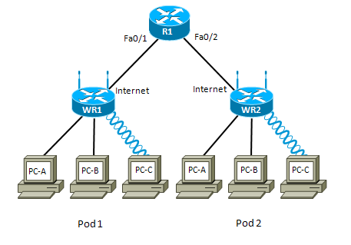
CCNA Discovery:
Networking for Home and Small Business
The router simulates only the ISP connectivity, no student configuration of the router; topology represents an ISP, with a small office and a home office customer; multiple pods will be connected serially using the serial ports on the router.
Recommended six students per pod
One router (with integrated switch)
Two Linksys wireless routers
Minimum one USB wireless adapter
Supports three students per Linksys device, six students total
Lab Topology

Slide 92
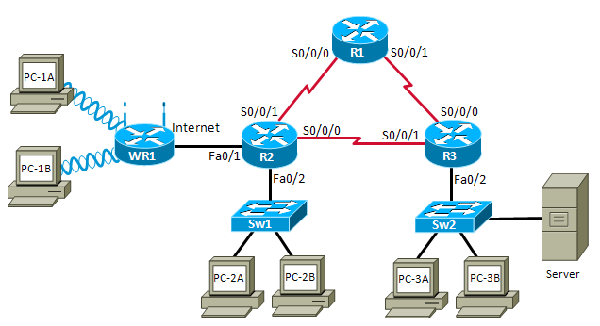
CCNA Discovery:
Networking at a Small-to-Medium Business or ISP:
Students will configure RIPv2 routing in a three-router topology; there is no specific configuration of the switches, other than basic setup; topology will be reconfigured during the course
Recommended six to eight students per pod
Three routers
Two switches
Minimum one Linksys wireless router
Minimum one wireless USB adapter (two preferred)
Lab Topology

Slide 93
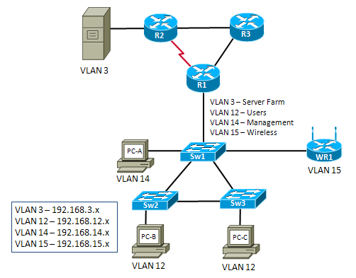
CCNA Discovery:
Introducing Routing and Switching in the Enterprise and Designing and Supporting Computer Networks
Three routers
Three switches
Linksys wireless routers
Recommend eight students per pod
This topology could be used for: Routing Protocols RIP, EIGRP, and OSPF - With or without switches
Lab Topology

Slide 94
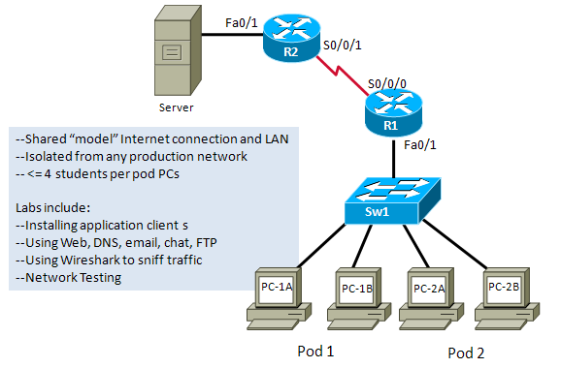
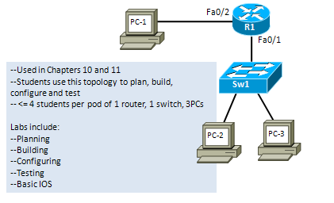
CCNA Exploration:
Network Fundamentals
Primary Hands-On Lab Pod
Shared “model” Internet connection and LAN
Isolated from any production networks
≤ four students per pod PCs
Secondary Lab Pod
Used in chapters 10 and 11
Students use this topology to plan, build, configure, and test
≤ four students per pod of one router, one switch, three PCs
Lab Topology

Slide 95
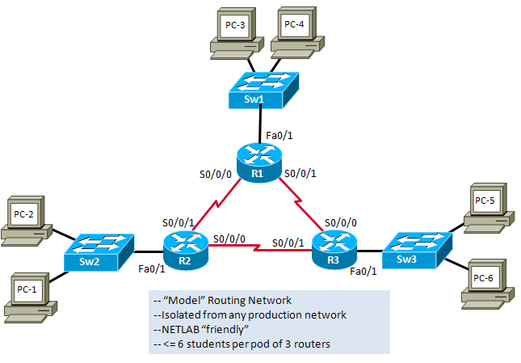
CCNA Exploration:
Routing Protocols and Concepts
“Model” routing network
Isolated from any production networks
NETLAB “friendly”
≤ six students per pod of three routers
Lab Topology

Slide 96
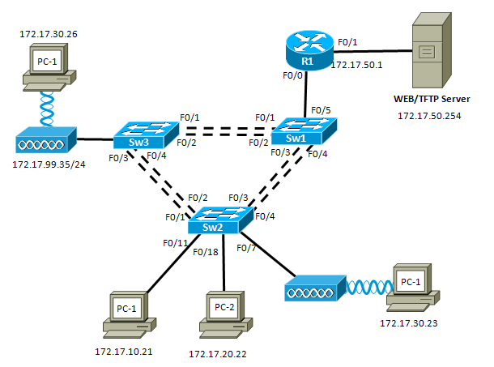
CCNA Exploration:
LAN Switching and Wireless
Lab Topology

Slide 97
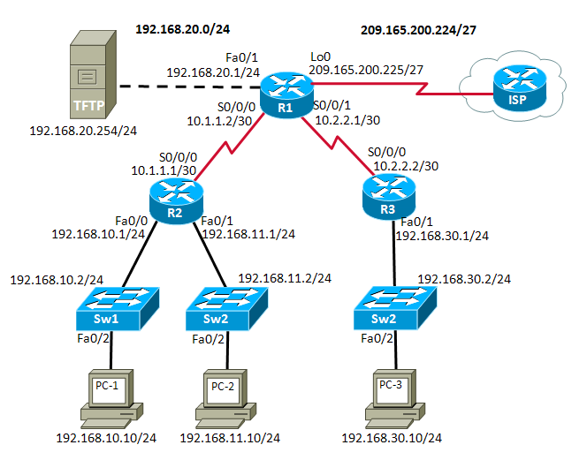
CCNA Exploration:
Accessing the WAN
Lab Topology

Slide 98

Cisco Certifications

Slide 99


Emergence of a Skills Gap
Future Converged Applications
The Role of the Network Grows
Video
Converged Solutions
Collaboration
Data Center/Storage
Knowledge Gap
Enhanced Security
Evolution of the Network
Wireless
Voice Transport
Telecommuting and VPN
Switching
Broad Education and Experience
Are Required for New Careers
Routing
Time
Notes:
The world’s networks continue to grow in technology complexity yet Customers’ and partners’ skills are short of desired state
Knowledge of networking fundamentals is no longer sufficient. Now, network professionals must understand networking systems with integrated security, wireless, and voice capabilities
In mature markets –The new game is designing networking systems with integrated security/wireless/voice capabilities.
In emerging markets -- core is critical but networks are quickly catching up and sometimes leapfrogging the US because there is no legacy to deal with (Korea/Singapore)
New careers in IT are being established that are more based on systems and architectures
Cisco needs to be leading the charge to provide direction and proper learning paths/resources to enable customers and partners to address these challenges
Cisco Networking Academy courses touch upon all of these topics and focus on preparing students for entry and associate level networking positions.

Slide 100
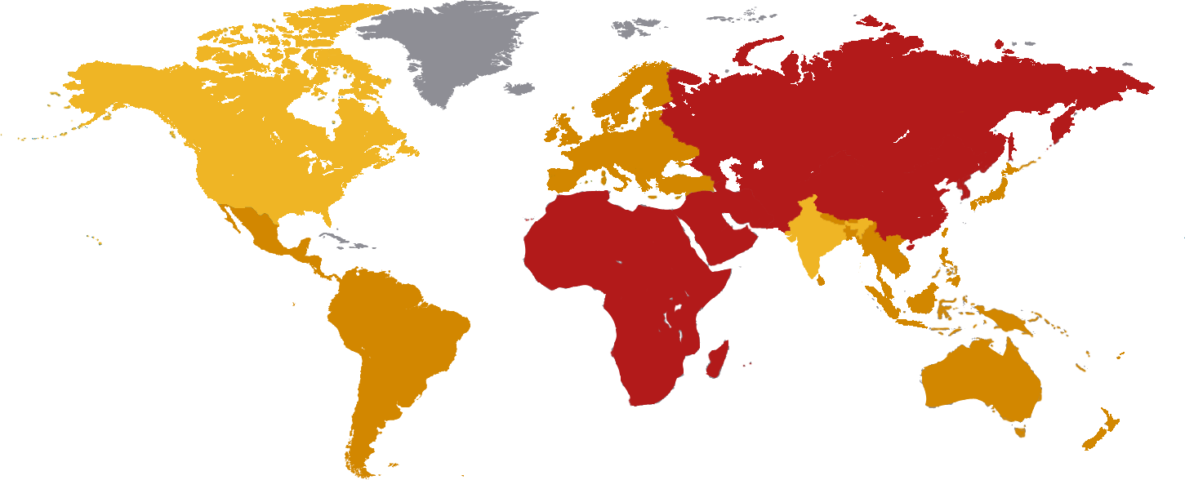
Broad and Deep Talent Gap
The Gap of Skilled Networking Professionals Is Estimated to be About 3 Million in 2012
North America Market Need: 656,000
Central and Eastern Europe, Russia, and CIS
Market Need: 261,000
China
Market Need: 430,000
Japan
Market Need: 179,000
Middle East and Africa
Market Need: 238,000
Rest of APAC
Market Need: 190,000
Latin America
Market Need: 216,000
India
Market Need: 334,000
Source: IDC Skill Gaps Research and Bain 2007 Global Job Market Analysis
Notes:
Right Experts, Right Place, Right Time
Cisco has conducted a comprehensive global networking talent study to assess how many networking professional will be needed by 2012.
Based on the collected data, we estimate that a gap of nearly 3 million skilled networking professionals will exist globally in 2012.
As you can see from the map no region is spared from the need to grow technical talent.
The breadth of the talent gap is therefore spread across the entire globe.

Slide 101


Cisco Career Certifications
A Lifecycle of Learning
CCENT
An Accessible Entry Point
CCNA
A Foundation in Networking
Cisco CCENT Entry-Level Network Technician certifies skills for entry-level network support
An intermediate step towards CCNA for those with little or no work experience
Greater breadth reflects today’s enterprise networks
Focus on performance-based skills and hands-on practice
Localization addresses worldwide skills gap
Notes:
The Cisco Certified Entry Network Technician, or CCENT. certification, is designed to help those just entering the field of networking, who may not yet be ready for the full CCNA curriculum or experienced enough to be a network associate.
CCENT is aligned with the tasks required of network support technicians and covers one-half of the CCNA curriculum and requires passing the first of the two CCNA exams.
CCNA, Cisco’s foundation level certification, is focused on preparing candidates for positions as network associates or network administrators.
And to address the worldwide need for networking skills, Cisco will be expanding its localization of the CCNA courses and exams.

Slide 102


Cisco Certification and Training
Value to Employers
Acquire
Prequalifies applicants
Develop
Proficient in the latest advanced technologies
Retain
Supports employee career development
Productivity
Credibility with prospective customers
“Our company’s technical footprint is greatly enhanced by our expert staff of Cisco certification holders.”
Carleton Jones, CEO of Multimax
Notes:
VALUE TO EMPLOYER SLIDE:
Cisco certifications help employers identify and acquire, develop and retain employees, while realizing productivity gains
Cisco Certification Provides an Objective Measurement of Skills, Helping it Attract Employees and Playing a Key Role in Winning New Business
Business Challenge
Headquartered in Herndon, Virginia, with operations worldwide, Multimax specializes in Cisco technology, delivering enterprise IT and communications services and solutions to support government organizations. By designing and deploying complete, 360-degree solutions tailored to meet enterprise requirements, Multimax helps customers optimize existing infrastructure assets and foster better collaboration and information sharing within their network environments.
Multimax is committed to delivering the most advanced technology solutions to its customers through highly qualified IT professionals. In fulfilling that commitment, the company continually seeks to extend its expertise and differentiate itself in a highly competitive market.
“Customers are looking for qualified service providers and the Multimax arsenal of Cisco Certifications makes us very attractive to prospective clients. When competing for highly sought after government contracts, service providers must distinguish themselves from the competition and demonstrate their breadth of technical expertise. Cisco Career Certifications provide a stamp of approval that accurately validates the qualification of our organization’s employees,” said Carleton Jones, CEO of Multimax.
The firm’s largest project, the Navy-Marine Corps Intranet (NMCI), employs hundreds of Cisco certified engineers working on a network comprised primarily of Cisco products. Connecting all Navy and Marine Corps communications onto one converged network, the NMCI is the second largest network in the world – after the Internet – with over 500,000 daily users.
Solution
From the company’s inception, Multimax has turned to Cisco and its certification program to enhance the knowledge of its network professionals. Cisco learning offerings include both online and instructor-led training courses, learning tools, skills assessments and exams that provide network professionals a structured format in which to enhance their technical knowledge and enjoy career advancement.
Because Multimax has long invested in professional development, Jones says that Cisco certifications are an integral part of the company’s culture. “Cisco Certified employees are always checking the Cisco website to be sure their certifications are current. We review the number of certifications each quarter, and we fund certifications for our employees,” he said. Three hundred and seventy-six Multimax technical employees have achieved at least the CCNA credential; of these, over 180 hold professional-level certifications, including CCVP and CCSP, and 25 have achieved CCIE. Many have also earned Cisco Specialist credentials.

Slide 103
Cisco Certifications
CCENT: Cisco Certified Entry Network Technician
Optional certification after the first two courses of CCNA Discovery curriculum
Certifies skills required to configure, operate and troubleshoot a small enterprise branch network, under supervision
Aligned to entry level positions in network support, such as help desk representative or technical support assistant
CCNA: Cisco Certified Networking Associate
Certifies knowledge and skills to install, operate and troubleshoot a small to medium size enterprise branch network
Includes connecting to multiple WANs, basic security measures, and wireless extension of the network

Slide 104
CCNA Curricula and Cisco Certifications
Certification | Recommended Curriculum | Certification Exam(s)
CCENT | CCNA Discovery Networking for Home and Small Businesses Working at a Small-to-Medium Business or ISP | ICND1 (640-822)
CCNA | CCNA Discovery Networking for Home and Small Businesses Working at a Small-to-Medium Business or ISP Introducing Routing and Switching Working at a Small-to-Medium Business or ISP OR CCNA Exploration Networking Fundamentals Routing Protocols and Concepts LAN Switching and Wireless Accessing the WAN OR CCNA Discovery Networking for Home and Small Businesses Working at a Small-to-Medium Business or ISP CCNA Exploration Routing Protocols and Concepts LAN Switching and Wireless Accessing the WAN | CCNA (640-802) OR ICND1 (640-822) and ICND2 (640-816)

Slide 105
Aligning Certifications to Jobs
Certification | Skills Certified | Job Roles | Job Titles
CCENT | Install, operate, and troubleshoot small-routed and switched networks Basic optimization of network Connect to other networks (LANs and WANs) Install a small wireless network Identify security threats and basic mitigation methods | Set up, install, and maintain PCs, servers, racks, and cabling Train users Support senior technicians Staff a help desk, retrieve calls, and isolate problems Use monitoring tools to verify network operations | Entry-Level Help Desk Technician Entry-Level Technical Support IT Systems Coordinator Entry-Level Operating Center Technician Entry-Level IT Technician/Specialist
CCNA | Install, operate, and troubleshoot medium-sized routed and switched networks Implement and troubleshoot various protocols to manage addressing, perform load balancing and authentication Establish and troubleshoot connection to service provider over WAN | Assist in design, installation, configuration, and maintenance of medium-sized routed and switched networks Isolate network problems Support users via help desk for hardware, software, and network Use monitoring tools to ensure network operations | Help Desk Support Specialist Network Technician Network Specialist Network Administrator Technical Support Specialist Network Engineering Technician

Slide 106


Certifications and Vouchers
Discount vouchers are offered to eligible students for the CCENT and CCNA exams
Cisco exams are offered through Pearson VUE authorized test centers (www.pearsonvue.com)
More information on the following topics is available in the Certifications and Vouchers area on Academy Connection
Industry certifications
Vouchers and promotional codes
Exams and testing centers
Special programs

Slide 107
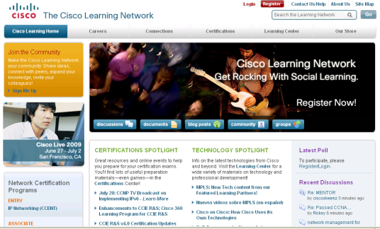
The Cisco Learning Network
Includes sample exam questions
E-learning modules
Tips from Cisco certified professionals
Other certification resources that will help candidates prepare for Cisco certification exams
Visit www.cisco.com/go/LearningNetwork

Slide 108


Slide 109


